Slide 1
Genetics pedagogies project
Have you:
Returned a completed consent form?
Signed your form?
Completed the online questionnaire?
Posted your blog entry?
If not – DO IT TODAY!!!!

Slide 2
Lecture 1: What is Genetics?
Genetics Pedagogies Project
Annie Jamieson (A.K.Jamieson@leeds.ac.uk)
Notes:
Register – check your details are correct
Ref to VLE and course docs.
Attendance: payment is up to me – just don’t take the mickey!!
Any problems, speak to me immediately
Interaction through lectures and blog: this is an experiment so lots of feedback required!
Lecture schedule
We can’t cover everything about genetics in just 10 lectures (the 1st year module has 33 lectures!) so we’re limiting ourselves to human genetics and the basic concepts required to understand that

Slide 3
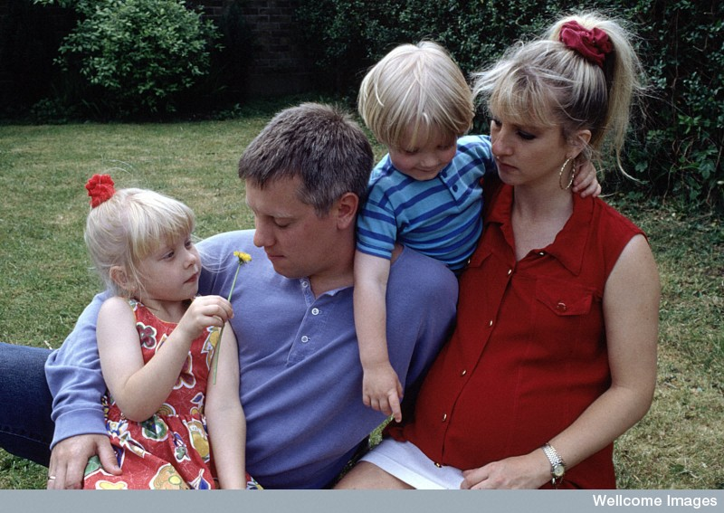
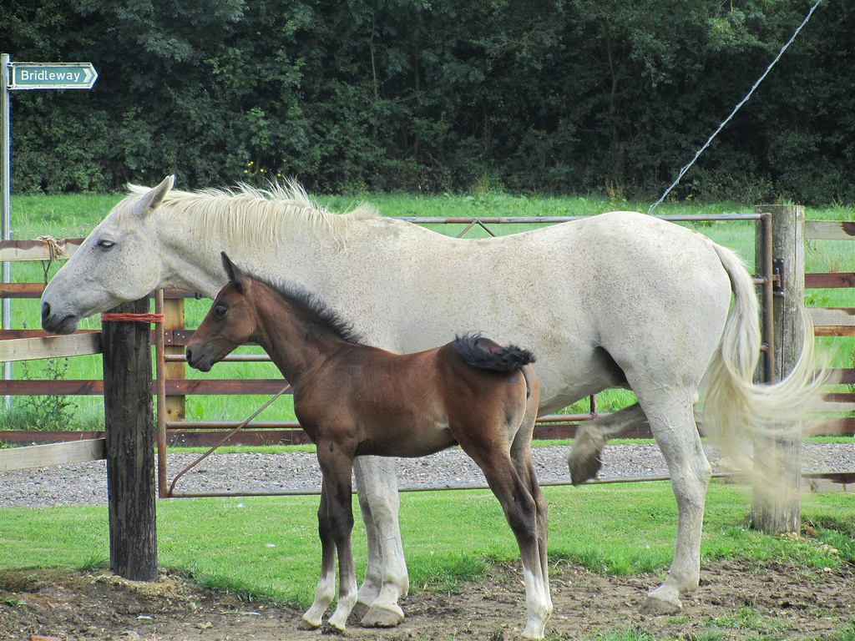
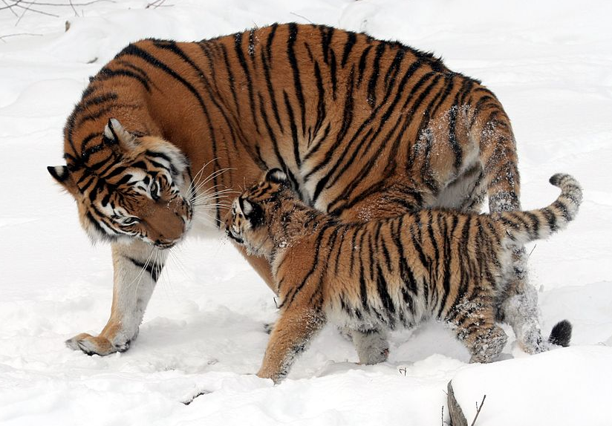
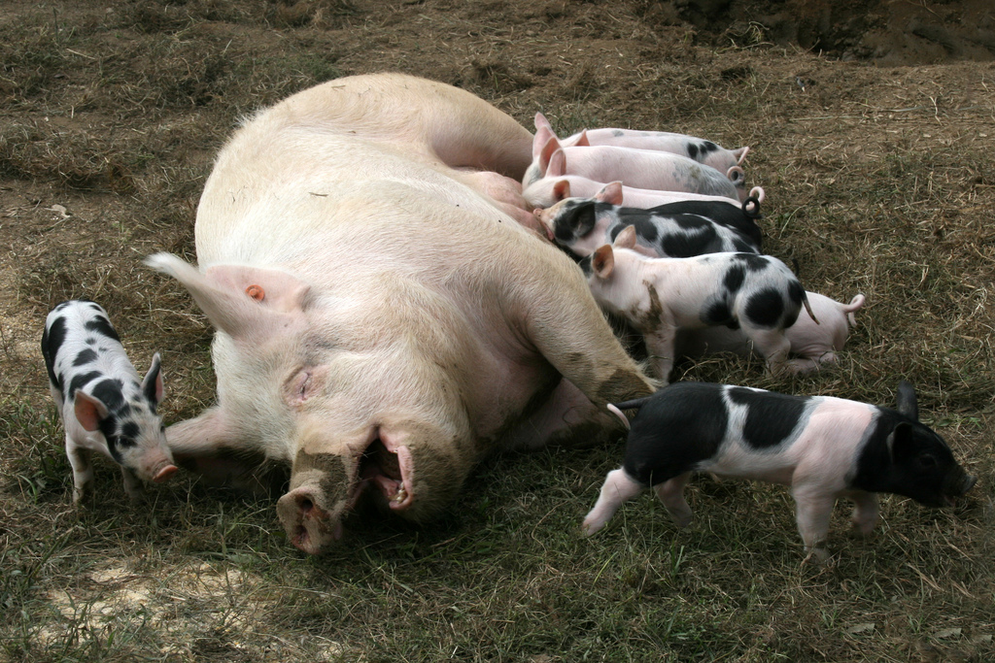
Inheritance as we observe it
Notes:
Inheritance as we observe it
Children are very similar to their parents in broad terms i.e. humans have human babies, cats have kittens and not puppies etc.
Children often share more similarities with their parents than with non-related individuals
e.g. dog breeds/ ethnic characteristics
May be more or less similar to the parent (e.g. horse quite different, tiger very similar)
But they are not identical to either parent or to their siblings (except for identical twins) (e.g. piglets)
What is the mechanism that ensures both this continuity of inheritance and this variation?
Genetics aims to answer this question

Slide 4
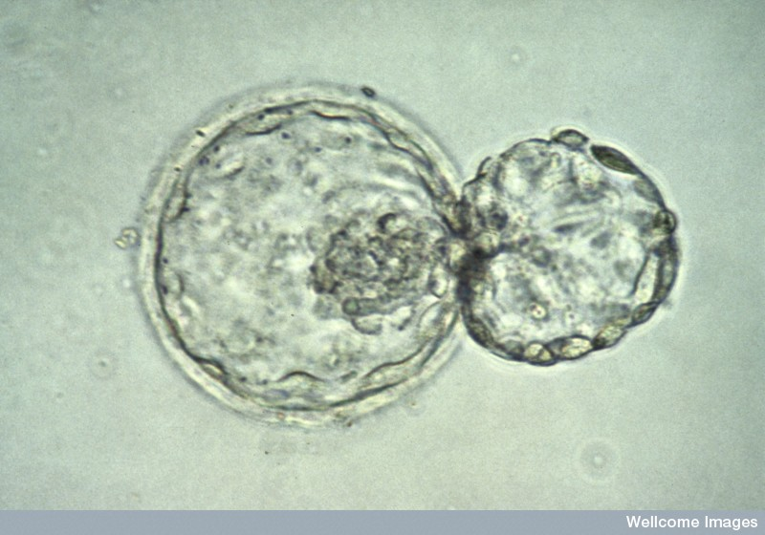
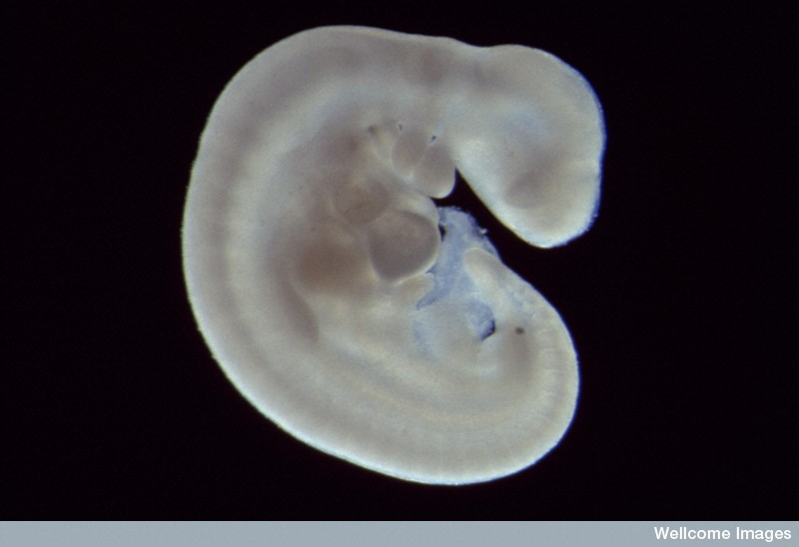
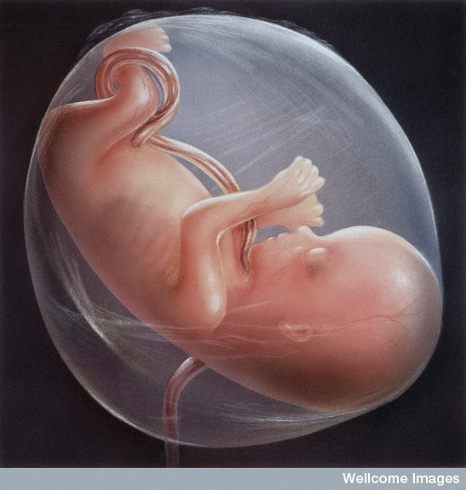
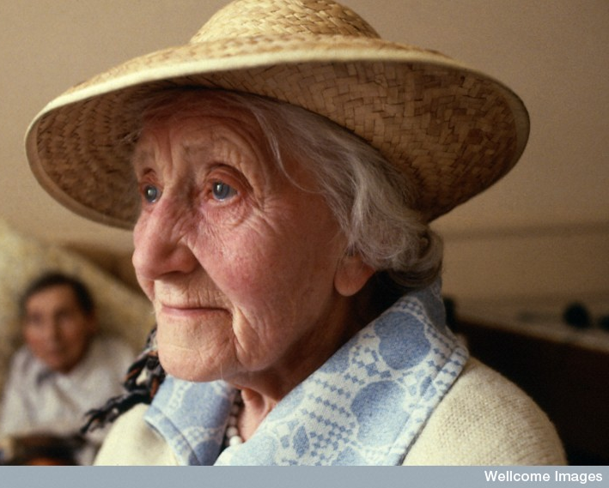
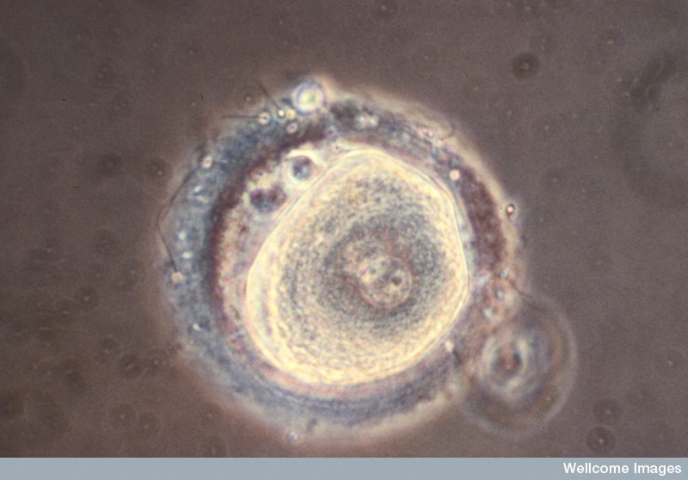
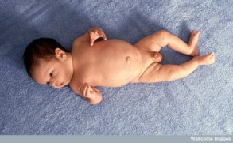
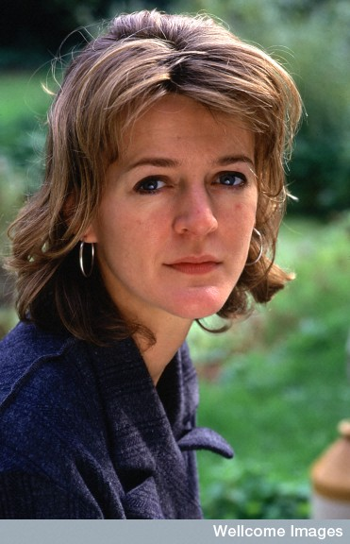
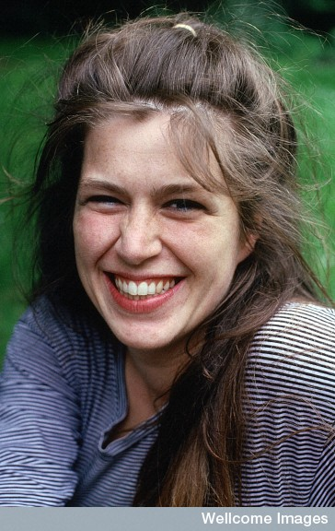
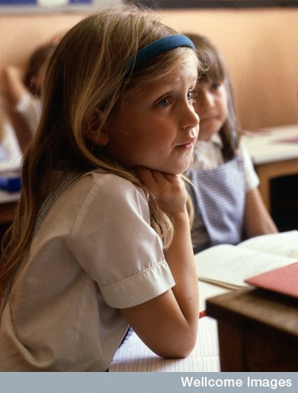
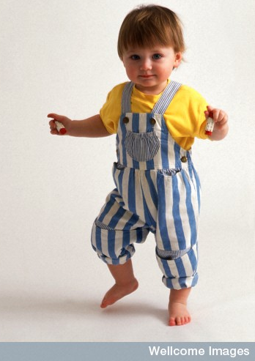
Inheritance and development
Notes:
Relationship between inheritance and development
Organisms are not born mature/complete: whatever is inherited has to go through a process of development to get from egg/sperm to mature individual
What is inherited i.e. genes guides development but does not entirely determine it
There are many other factors
In the simplest case – a fertilised egg would rapidly die if not provided with a suitable internal environment to grow – egg or womb
WHAT DOES “ENVIRONMENT” MEAN TO YOU?

Slide 5
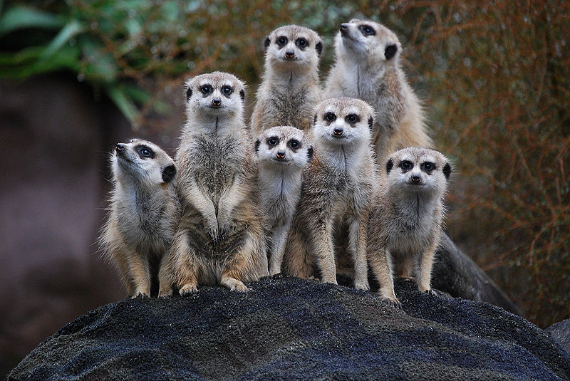
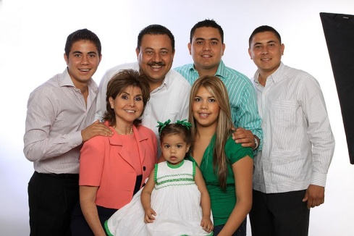
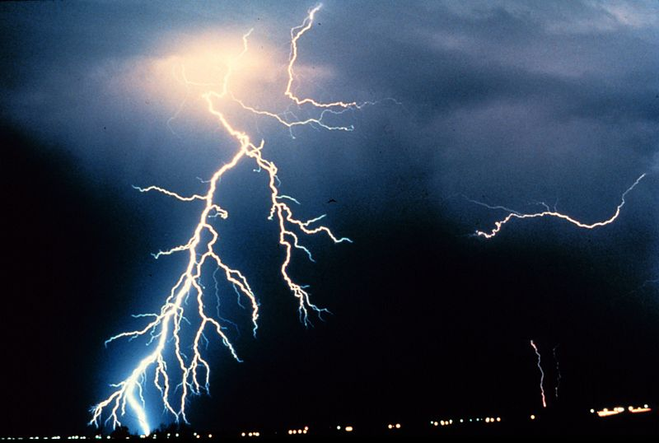
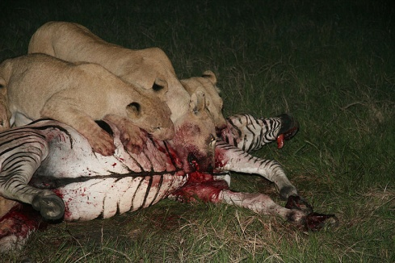
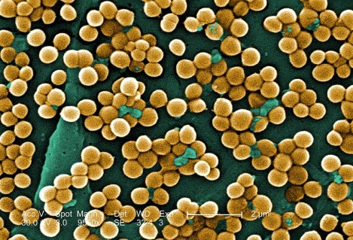
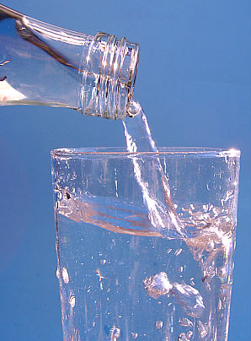
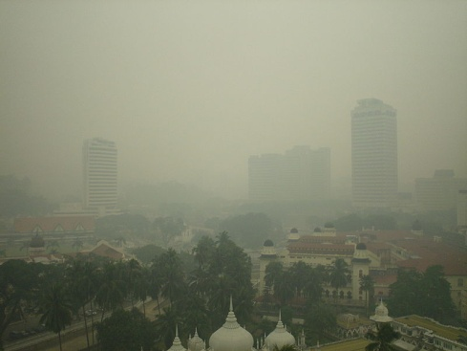
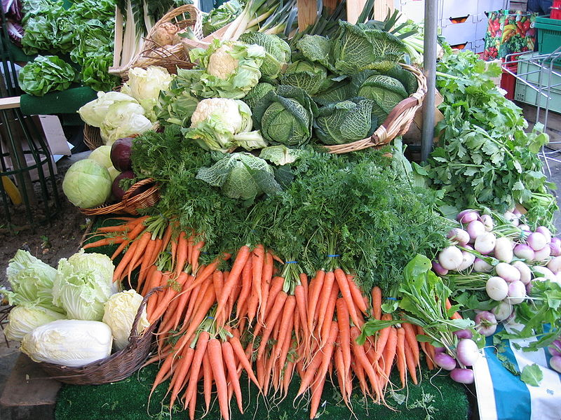
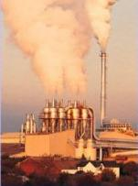
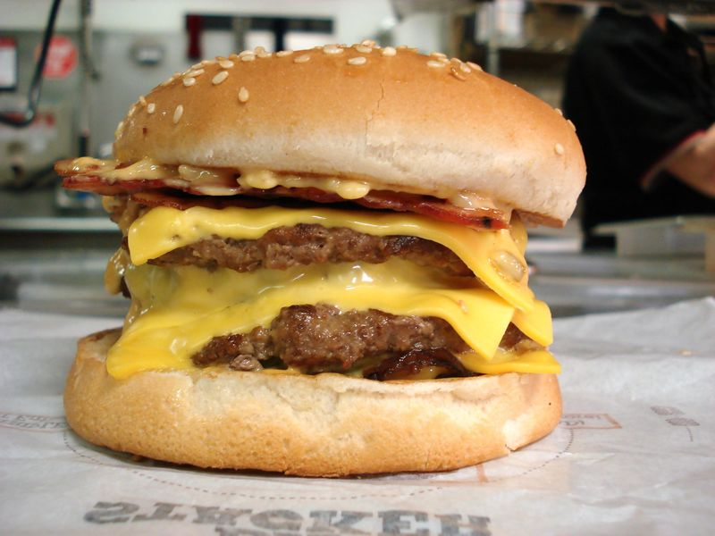
Organism and environment
Notes:
Organism and environment
What is the environment? Internal vs external
Environment is often thought to be “outside” – food/drink, weather/climate, chemicals/pollution etc
Also includes other individuals – family/society, of the same and different species
There is a very complex interaction between genes and environment
Simple examples of traits affected by inheritance and by environment
MRSA image: Wikipedia commons This image is a work of the Centers for Disease Control and Prevention, part of the United States Department of Health and Human Services, taken or made as part of an employee's official duties. As a work of the U.S. federal government, the image is in the public domain.
Lion image: Wikimedia Commons: jsohn1@pacbell.net
This file is licensed under the Creative Commons Attribution-Share Alike 2.0 Generic license.You are free:to share – to copy, distribute and transmit the work
to remix – to adapt the work
Under the following conditions:attribution – You must attribute the work in the manner specified by the author or licensor (but not in any way that suggests that they endorse you or your use of the work).
share alike – If you alter, transform, or build upon this work, you may distribute the resulting work only under the same or similar license to this one.

Slide 6
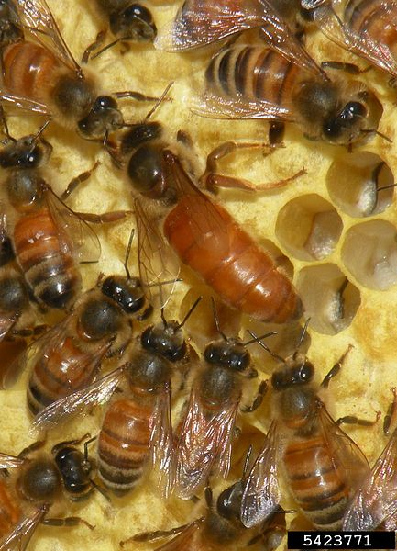
Genes, environment and the honey bee
Queen and workers are genetically identical
Larvae fed initially on royal jelly then switched to pollen = sterile workers
Larvae fed exclusively on royal jelly = fertile queens
Source: Wikimedia Commons
Notes:
Organisms with the same inheritance can develop in very different ways
Bees/ants – queens and workers genetically identical but morphologically very different due to different “upbringing”: queens are fertile, workers have pollen baskets and other structures to aid pollen and nectar collection etc, which queens don’t have
All larvae are fed on royal jelly (a glandular secretion produced by certain workers) for three days, but workers are then moved onto pollen and nectar, while would-be queens continue on royal jelly
Queen bees are fed a special diet as larvae which ensures they develop into sexually mature specimens

Slide 7
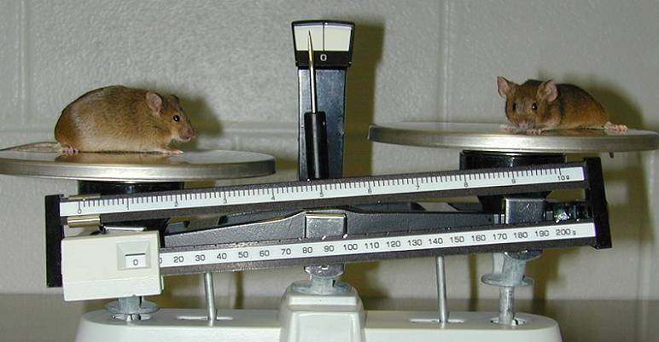
Genes, environment and fat mice
ob gene in mice encodes leptin, a hormone which regulates appetite and energy expenditure
Mice with mutant ob become morbidly obese
Notes:
Different responses to same environment e.g. human obesity
Different individuals respond differently to food
Some can eat the same diet and yet one will gain more weight than another
Some people have no inclination to over eat, no matter how much food is available but others find it very difficult to resist
1994 Jeffrey Friedman – Ob gene in lab mice
Ob gene in mice – discovered in 1994. Leptin is a hormone that is involved in appetite regulation and metabolism. The ob mutation causes mice to be abnormally obese – affecting both appetite and metabolism.
Image source: Lexicon Genetics Incorporated (Wikimedia Commons)

Slide 8
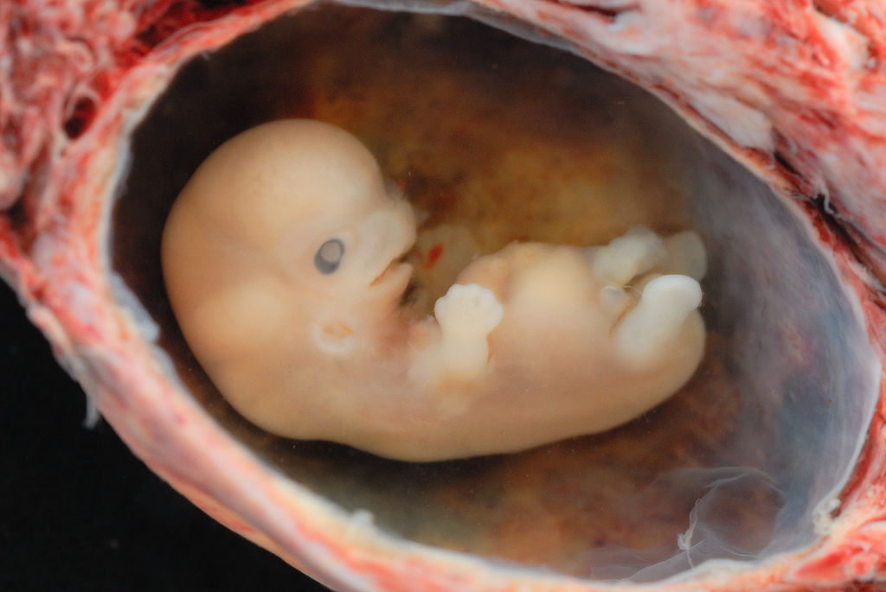
Internal environment: Congenital anomalies
Jacapo Werther: Wikimedia Commons
Affect approx. 1 in 33 babies (WHO)
50% due to genetic/environment/infectious factors
50% have no identified specific cause
Notes:
There is also an internal environment. Initially, the mother’s womb
Congenital anomalies:
Affect c. 1 in 33 babies
Cleft palate
Neural tube closure
Heart defects
Sensory defects
Learning difficulties
Genetic/infectious/environmental (but 50% have no known specific cause)
In the optional reading you can find a link to the WHO factsheet on this
IMAGE: Approximately 6 weeks from conception, i.e. 8 weeks from LMP. Shot with 105 mm Micro-NIKKOR lens with 2 off camera SB-800's. Specimen is submerged in alcohol. This is a spontaneous (ie. not a termination) abortion. It was extruded intact with the gestational sac surrounded by developing placental tissue and decidual tissue. This was carefully opened to avoid damaging the embryo.

Slide 9
Factors in congenital anomalies
Infections: e.g. rubella
Chemicals: pesticides, heavy metals (lead, mercury etc)
Radiation
Medicines: thalidomide; retinoic acid (acne medications)
Recreational drugs
Alcohol
Smoking
Maternal nutrition: folic acid; iodine
Notes:
Substances that can affect the foetus in the womb include:
Infections: rubella, (hearing and visual impairments, heart problems)
Pollution and pesticides: Heavy metals e.g. mercury lead etc.
Radiation
Medicines:
Thalidomide (early 1960s)
Retinoic acid (in acne treatments: hearing and visual impairment, missing or malformed earlobes, facial dysmorphism, and mental retardation)
Alcohol
Smoking
Recreational drugs
Maternal diet: obesity/uncontrolled diabetes/ malnutrition/specific nutrients e.g. folic acid
Supplementation with folic acid can prevent more than half of all neural tube birth defects
More in Lecture 2
Spina bifida: failure of neural tube to close. Key time stage around day 27. Symptoms depend on the degree of failure – from still birth in which the forebrain has not developed, through paralysis, lack of feeling, problems with bladder/bowel function and control, or brain damage due to fluid build up in the brain. Some cases are very mild, with no exposure of spinal nerves and may have no symptoms.

Slide 10
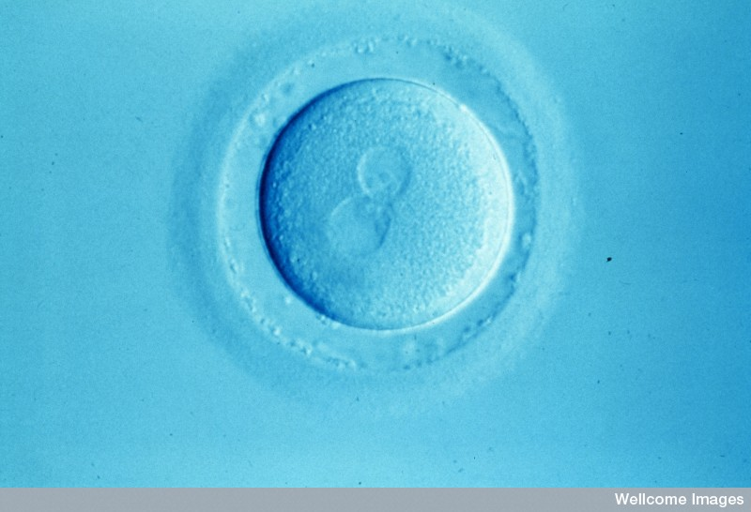
Internal environment
Human egg shortly after fertilization. Parental pro-nuclei are about to fuse.
Notes:
but even earlier the egg (especially) and sperm provide the environment for the very first cell divisions in development
Again we’ll talk more about this next week but let’s have a look at an example from Drosophila
B0001451 Credit Alan Handyside, Wellcome Images Newly fertilised human egg Human egg soon after fertilisation viewed using Nomarski optics. The two parental pronuclei are clearly visible and have not yet fused. Nomarski optics micrograph Collection: Wellcome Images Copyrighted work available under Creative Commons by-nc-nd 2.0 UK: England & Wales, seehttp://wellcomeimages.org/indexplus/page/Prices.html

Slide 11
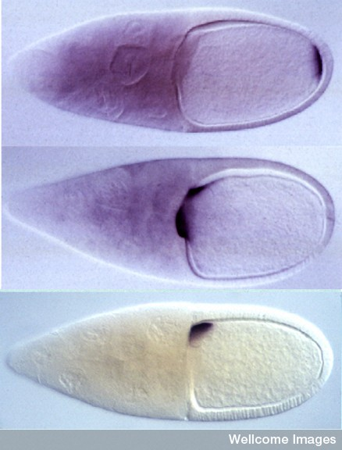
Drosophila egg before fertilisation
Bicoid protein directs head/thorax (anterior) development
Oskar protein directs abdominal (posterior) development
Gurken protein defines dorso-ventral axis
Notes:
Drosophila egg before fertilisation: oocyte on right, nurse cells on left – these accumulate nutrients which will become the “yolk”
Uses a technique called “in situ hybridization”, in which specially created probes bind to mRNA to show where certain genes are being expressed
Top: bicoid directs head/thorax development
Middle: Oskar directs abdominal/germline (posterior)
Bottom: Gurken: defines dorso-ventral axis
To summarise so far: genes and environment interact in many ways, throughout life, to make you the way you are, and there are both external and internal environmental factors to consider
Moving on for today, there are some basic terms that we need to understand. A question: How many of you know your blood type? Do you know why you have that type?
B0003778 Credit Dr Daniel St. Johnston, Wellcome Images Drosophila embryo polarity The localisation of bicoid, oskar and gurken mRNAs in the Drosophila oocyte defines the anterior-posterior and dorsal-ventral axes of the embryo. In situ hybridisations to bicoid (top), oskar (middle) and gurken (bottom) mRNAs in stage 10 Drosophila egg chambers. The egg chambers consists of 15 nurse cells and a large oocyte (right), which is surrounded by a layer of somatic follical cells. Bicoid mRNA localises to anterior of the oocyte, directing where head and thorax of embryo develop. Posterior localisation of oskar mRNA directs formation of the pole plasm that contains the abdominal and germline determinants. Gurken is translated on the dorsal side, producing a signalling molecule that causes adjacent follical cells to define the embryo's dorsal-ventral axis. Collection: Wellcome Images Library reference no.: Contributor Reference OSKBODGRK2 Copyrighted work available under Creative Commons by-nc-nd 2.0 UK: England & Wales, seehttp://wellcomeimages.org/indexplus/page/Prices.html

Slide 12
Terminology
Phenotype
Genotype
Haploid/diploid
Gene
Genome
Locus
Allele
Homozygous/ heterozygous

Slide 13
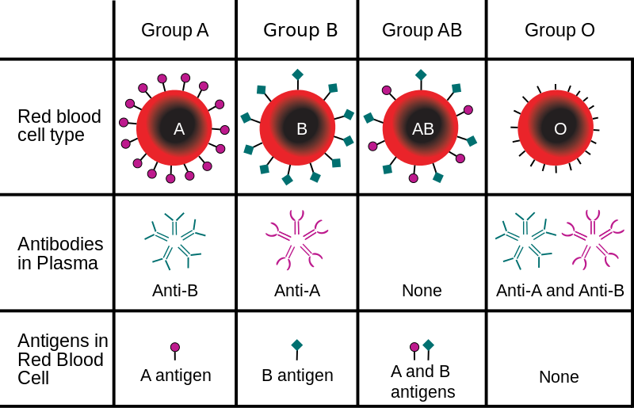
Source: Wikimedia Commons. Creator: InvictaHOG
Notes:
ABO Blood groups
Red blood cells have proteins on their outer surfaces. Some of these proteins are known as antigens and they are the target of antibodies in the immune response. We categorise people’s blood groups by the type of antigen on the blood cells (there is more than one system for this – the Lewontin reading, for example refers to the MN system, which refers to other antigens on the RBCs)
Type A has A antigens and anti-B antibodies
Type B has B antigens and anti-A anti-bodies
Type AB has A and B antigens and no antibodies
Type O has no antigens and both anti-A and anti-B antibodies
The blood group – the existence of particular antigens – is the phenotype i.e. the physical appearance/state of the individual
The gene or genes that play a role in the physical characteristic are called the genotype – note that there are other factors involved besides the genes, and that one characteristic might be affected by a number of genes, and equally one gene may play a role in more than one characteristic
We’ll go into more detail of the structure of DNA, and the genome and how it all works in Lectures 3-5, but we’ll just have a quick look now to establish some more terminology

Slide 14
Human karyotype
Source: http://www.genome.gov/glossary/resources/karyotype.pdf
Notes:
Human genes are sequences of DNA, which is packaged into chromosomes
Karyotype = chromosome profile – all the pairs are matched up and arranged like this
Humans are diploid organisms – they have two copies of each chromosome (23 x 2 [actually 22 x 2, plus the sex-chromosomes, which aren’t a matched pair but we’ll come back to that in Lecture 6]), one from each parent (egg and sperm are haploid i.e. carry one copy of each and they come together at fertilization to create a diploid individual), hence two copies of each gene, which may or may not be the same, depending on the genotype of the parent.
Note: Some organisms are haploid throughout the greater part of their life cycle e.g. fungi, algae, and male bees and ants are haploid as they develop from unfertilised eggs

Slide 15
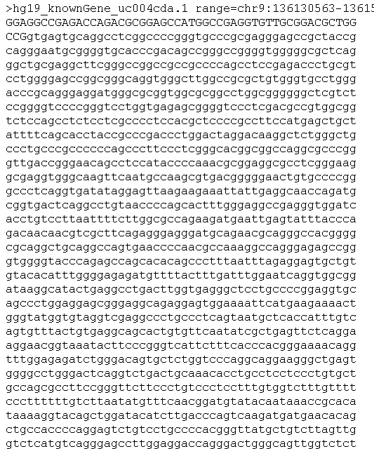
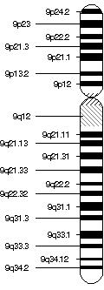
Notes:
Gene
A sequence of DNA that affects a given characteristic of an organism by producing a protein or RNA molecule e.g. ABO on human chromosome 9. Note that there are many different perspectives on the definition of a gene – biological, philosophical etc. – this is “working definition” of a gene, without being dogmatic about it = “ this is a gene for our purposes”
Genome
The complete genetic make-up of an individual or species (for all characteristics)
ABO = approx 20k base pairs (about the first 1700 shown here) all info you can find via OMIM (in web resources list)
The “space” on the chromosome for the blood group gene is called the locus
in blood groups are found on chromosome 9 (9q34.1-q34.2)

Slide 16
Locus
Allele1
Allele 2
Allele 2
Homozygote
for 1
Heterozygote
Homozygote
for 2
Notes:
Let’s look at a simplified example: this is a fictitious chromosome
Locus is the space for the gene
Allele = One or more alternative variations of a particular gene that can exist at that gene locus e.g. A, B, and O alleles for blood groups
Individuals who have two copies of the same allele e.g. 11 are called homozygous
Those with two different copies e.g. 12 are called heterozygous
In the ABO blood group, the locus can be occupied by one of three variations of the gene: A or B or O alleles

Slide 17
A allele = A antigens
B allele = B antigens
O allele =non-functioning protein = no antigens
Phenotype | Genotype
Blood group A | AA or AO
Blood group B | BB or BO
Blood group AB | AB
Blood group O | OO
Notes:
The A allele causes the production of A antigens
The B allele causes the production of B antigens
The O allele causes the production of a non-functioning protein so no antigens are produced
Blood group AB (universal recipient because the individual does not produce either anti-A or anti-B antibodies to attack the donated blood cells)
Blood group O (universal donor because the RBCs contain no antigens to be attacked by the recipient’s immune system)
Variant alleles can have different kinds of effects – in this case, the O allele leads to a protein that doesn’t function at all, in other cases there might be a protein product that has a different function

Slide 18
Diet
Genes
Blood
pressure
High triglycerides
High cholesterol
Ethnicity
Diabetes
Age
Cardiovascular disease
Obesity
Sex
Stress/ class
Activity
Alcohol
Smoking
Notes:
“CVD includes all the diseases of the heart and circulation incl coronary heart disease (angina and heart attack), heart failure, congenital heart disease and stroke. In 2011, almost 160,000 people in the UK died from CVD. 74,000 of these deaths were caused by coronary heart disease - the UK's single biggest killer.” (BHF, http://www.bhf.org.uk/heart-health/conditions/cardiovascular-disease.aspx)
In 2010, more than 45,000 people under 75 years died in the UK – 180,000 in total
292 million prescriptions for CVD in 2011
UK healthcare costs in 2009 = £8.7 billion (All from BHF Compendium, 18th edition, 2012)
Genes
Several single gene mutations have been identified, affecting mitochondrial function, contractile proteins, calcium cycling (in muscle contraction) etc.
Ethnicity (BHF website): must be some genetic component but also environmental/ cultural
coronary heart disease rates highest in South Asian communities
stroke rates/ risk of high blood pressure highest in people with an African Caribbean background
prevalence of type-2 diabetes for people of African Caribbean and South Asian ethnicity is much higher than in the rest of the population.
Age - the older you are, the more likely you are to develop CVD (BHF website)
Sex - men are more likely to develop CVD at an earlier age than women and significantly more likely to die of it than women (BHF website)
High levels of alcohol use, esp in binges, increase risk: associations with alcohol metabolism, addiction, risk-taking behaviour etc
Smoking almost doubles your risk (BHF website): associations with addition, risk-taking etc.
CHD mortality 60% higher in smokers than non-smokers, 80% higher in heavy smokers (BHF Compendium, 18th edition)
Regular physical activity lowers risk of CHD., whereas Obesity – more than doubles risk of heart attack: genetic associations
Diabetes – diagnosis increase risk of heart attack threefold: 75% of diabetics die of heart disease: known genetic link
Blood pressure – risk increases as pressure increases (in Western Europe, history of high blood pressure doubles risk of heart attack): known genetic link
Cholesterol – in Western Europe abnormally high levels triple risk of heart attack: known genetic disease
Class – CHD higher in lower socioeconomic groups and lower in higher socioeconomic groups: environmental
Stress: environmental BUT it’s not impossible that there could theoretically be a genetic predisposition to the adverse effects of stress
Also consider learned behaviour: eating habits, attitudes to drinking, smoking etc.
So, we can’t point to “the gene for” CVD, in the hope that we can fix it, or change it, or replace it, to prevent or cure the disease – and this is true of the vast majority of human traits (we’ll see some exceptions later in the course) BUT we can break down the complexity and understand various components of it – we just have to always remember that it is just one component of a network of influences.

