Slide 1
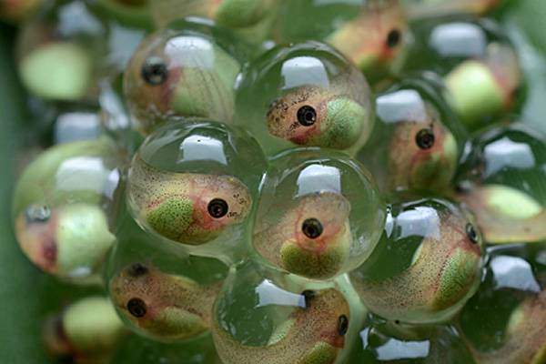
Lecture 2: basic development
Genetics Pedagogies Project
Annie Jamieson (A.K.Jamieson@leeds.ac.uk)
Notes:
Still some unsigned consent forms – see me after the lecture
Has everyone found the resources on the VLE?
Any problems anyone would like to raise?
Xenopus embryos
Image: http://ucsdhealthsciences.tumblr.com/post/33233370794/tidings-of-stem-yesterdays-announcement-that COPYRIGHT ISSUES

Slide 2
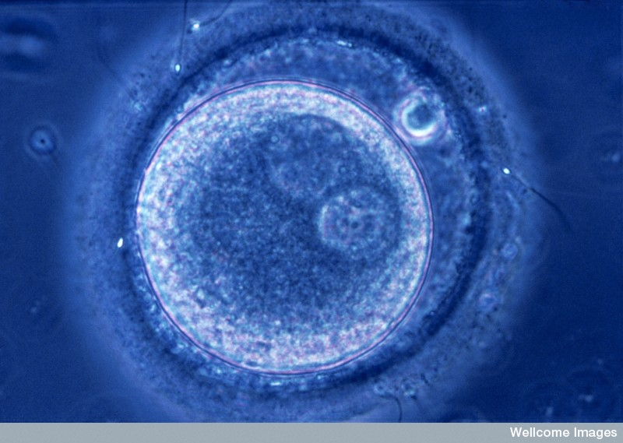
Development = one cell to many cells
Human zygote
From a single fertilized egg…
To 50-70,000,000,000,000 cells
c. 200 different cell types
Notes:
One cell  many cells (and of many different types e.g nerve, muscle, liver, bone, blood)
Between 50-70 trillion cells in the adult human body and around 200 cell types
N0013848 Credit Wellcome Images, Wellcome Images. Fertilization. Zygote, human. Fertilization Pmic, unicellular fertilised egg. CMSP ref: Z131-N-1 E9 reproductive system. Photomicrograph Collection: Wellcome Images Library reference no.: Contributor Reference Z131N1 and NMSB Frame No NOVIDEO Copyrighted work available under Creative Commons by-nc-nd 2.0 UK: England & Wales, seehttp://wellcomeimages.org/indexplus/page/Prices.html

Slide 3
Zebrafish development
Notes:
Just a quick glance at this process in one of the most important model organisms in developmental genetics
http://www.swarthmore.edu/NatSci/sgilber1/DB_lab/Fish/fish_stage.html COPYRIGHT ISSUES
4 cell = 1h
Oblong stage = 3h 40m
Epiboly (http://worms.zoology.wisc.edu/frogs/gast/gast_momor.html)
During epiboly, a sheet of cells spreads by thinning. i.e., the sheet thins, while its overall surface area increases in the other two directions. Epiboly can involve a monolayer (i.e. a sheet of cells one cell layer thick), in which case the individual cells must undergo a change in shape. In other cases, however, a sheet that has several cell layer can thin by changes in position of its cells. In this case, epiboly occurs via intercalation, one of the other movements described on this page.

Slide 4
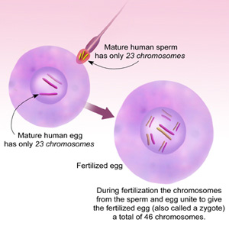
fertilization
The haploid GAMETES or GERM CELLS fuse at fertilization to form a diploid, single-cell ZYGOTE
The zygote contains one copy of each chromosome inherited from the mother and one copy of each inherited from the father
Cell cytoplasm from mother
Notes:
Starting point in development – fertilization = 1 diploid cell: zygotic genome, maternal cytoplasm
Formation of a zygote by fertilization Credit: National Institutes of Health

Slide 5
Genomic equivalence
The genome is established in the zygote and is transmitted to every subsequent somatic cell
Each cell expresses only a small proportion of the genes it contains
Genes which are not used in a particular cell are not lost or irreversibly inactivated – they retain the potential for expression
P
D¹
D²
D¹
D²
D¹
D²
Notes:
All the cells of an organism contain the same set of genes (pack of cards, represented by the black dot)
Each cell expresses a sub-set of the genes (plays a different hand, represented by the different colours)
Differentiated cell types express different sets of these genes
Some genes are ”house-keeping” genes which are expressed in most/all cells and which support basic cellular processes (a recent study has identified almost 4000 human house-keeping genes – many are involved in cell membrane structure, cell division processes, energy metabolism and so on)
Others are specific to certain cell-types and activities e.g. the ABO gene we looked at last week is only expressed in red blood cells

Slide 6
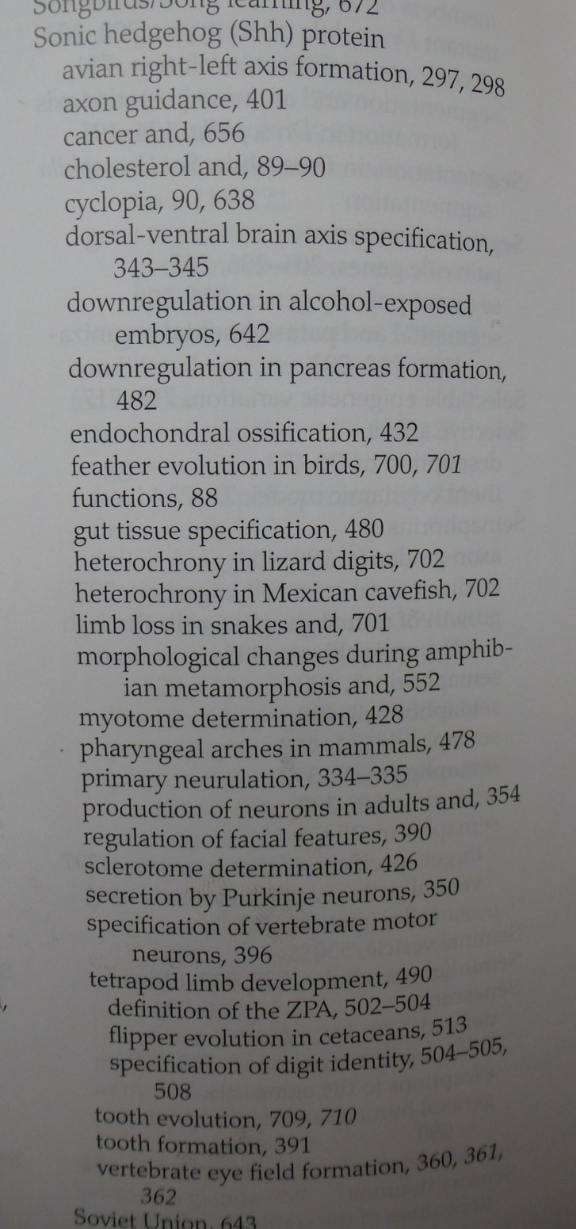
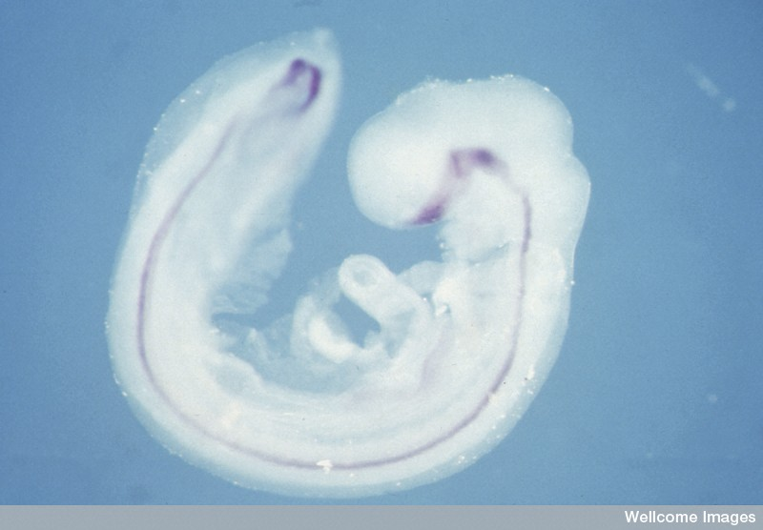
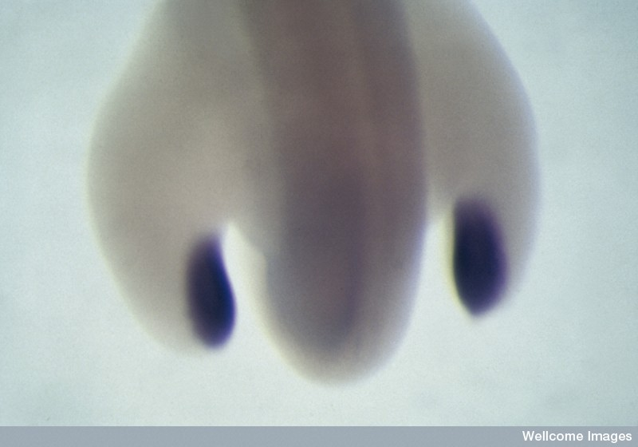
Multi-functional genes: sonic hedgehog
Notes:
Some genes play different roles in different cell types, locations and times e.g. sonic hedgehog
B0001720 Credit Abigail Tucker, Wellcome Images. Expression of the sonic hedgehog gene Lateral view of a stage 15 chick embryo (50-55h) showing the regions where the sonic hedgehog gene is switched on (purple). The mRNA is being made in the notochord and floorplate of the brain and spinal cord, both of which run along the length of the embryo. It is also produced in the ventral part of the forebrain. Collection: Wellcome Images Library reference no.: BSIP Copyrighted work available under Creative Commons by-nc-nd 2.0 UK: England & Wales, seehttp://wellcomeimages.org/indexplus/page/Prices.html
B0000073 Credit M. Cohn, Wellcome Images. Chick embryo hindlimbs The developing hind limb buds of a four to five day chick embryo. The blue staining shows expression of the sonic hedgehog gene involved in limb development. Collection: Wellcome Images Library reference no.: BSIP Copyrighted work available under Creative Commons by-nc-nd 2.0 UK: England & Wales, seehttp://wellcomeimages.org/indexplus/page/Prices.html

Slide 7
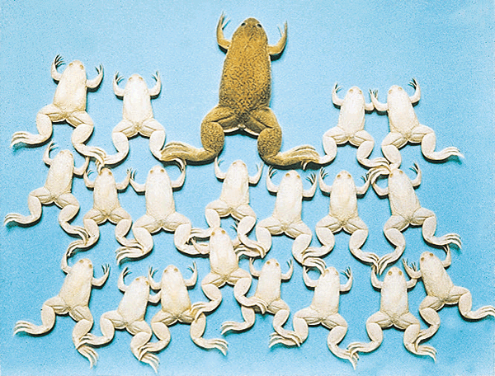
evidence for genomic equivalence
Wild-type female “egg-donor” frog with albino cloned offspring. From: J. B. Gurdon and Alan Colman. ‘The future of cloning’. Nature 402, 743-746(16 December 1999) doi:10.1038/45429
Notes:
This concept that cells retain all their genetic information and potential was proved in the 1970s by John Gurdon
Gurdon cloned these frogs in 1977: via nuclear transplantation of dissociated cells of a stage 18 albino tadpole into enucleated eggs of a wild-type female
COPYRIGHT ISSUES http://www.nature.com/nature/journal/v402/n6763/fig_tab/402743a0_F2.html
From the following article: The future of cloning J. B. Gurdon and Alan Colman Nature 402, 743-746(16 December 1999) doi:10.1038/45429
“These 19 identical male albino frogs were prepared by nuclear transplantation into unfertilized eggs of the dark green female frog³³. (Male frogs are about half the size of females.)”

Slide 8
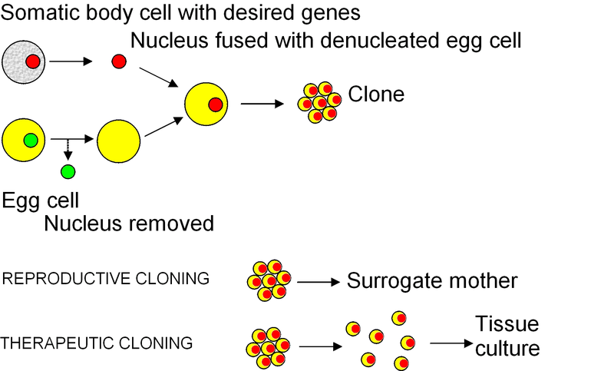
Cloning as evidence for genomic equivalence
Notes:
Gurdon (Nobel Prize last year for stem cell research)
Permission is granted to copy, distribute and/or modify this document under the terms of the GNU Free Documentation License, Version 1.2 or any later version published by the Free Software Foundation; with no Invariant Sections, no Front-Cover Texts, and no Back-Cover Texts. A copy of the license is included in the section entitled GNU Free Documentation License.
This file is licensed under the Creative Commons Attribution-Share Alike 3.0 Unportedlicense.You are free:to share – to copy, distribute and transmit the work
to remix – to adapt the work
Under the following conditions:attribution – You must attribute the work in the manner specified by the author or licensor (but not in any way that suggests that they endorse you or your use of the work).
share alike – If you alter, transform, or build upon this work, you may distribute the resulting work only under the same or similar license to this one.
This licensing tag was added to this file as part of the GFDL licensing update.

Slide 9
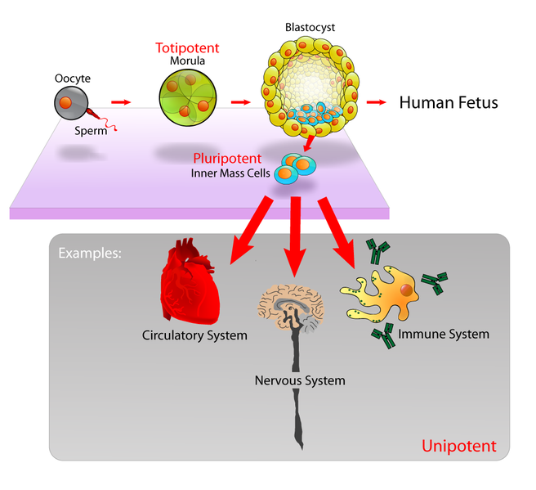
Cell potentials
Notes:
To go back to the point that genes which are not used in a particular cell are not lost or irreversibly inactivated – they retain the potential for expression
Totipotent cells can develop into any embryonic structure and extra-embryonic cells (chorion i.e. embryonic part of the placenta)
Pleuripotent cells can become any embryonic cell type – which is why ICMs are favoured for stem cell research
Unipotent cells can only replicate themselves
http://en.wikipedia.org/wiki/File:Stem_cells_diagram.png
This file is licensed under the Creative Commons Attribution-Share Alike 2.5 Generic license.You are free:to share – to copy, distribute and transmit the work
to remix – to adapt the work
Under the following conditions:attribution – You must attribute the work in the manner specified by the author or licensor (but not in any way that suggests that they endorse you or your use of the work).
share alike – If you alter, transform, or build upon this work, you may distribute the resulting work only under the same or similar license to this one.

Slide 10
Cell differentiation depends on communication
“The behaviour of a cell in an embryo depends on the extent to which it listens to its mother or its neighbourhood. The size and nature of the noise, the way in which it is heard, and the response are unpredictable and can only be discovered by experimentation.”
Jonathan Bard (1997) quoted in Scott Gilbert, Developmental Biology, 10th ed., 2014, p. 67.
Notes:
Cell differentiation depends on cells receiving and responding to signals (by turning genes on and off) – from the maternal cytoplasm, from own nucleus (genes), from cells around them, and from the environment

Slide 11
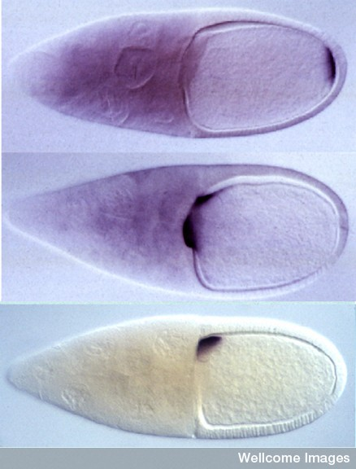
Maternal gene effects
Bicoid protein directs head/thorax (anterior) development
Oskar protein directs abdominal (posterior) development
Gurken protein defines dorso-ventral axis
Notes:
Drosophila egg before fertilisation: oocyte on right, nurse cells on left – these accumulate nutrients which will become the “yolk”
Uses a technique called “in situ hybridization”, in which specially created probes bind to mRNA to show where certain genes are being expressed
Top: bicoid directs head/thorax development
Middle: Oskar directs abdominal/germline (posterior)
Bottom: Gurken: defines dorso-ventral axis
B0003778 Credit Dr Daniel St. Johnston, Wellcome Images Drosophila embryo polarity The localisation of bicoid, oskar and gurken mRNAs in the Drosophila oocyte defines the anterior-posterior and dorsal-ventral axes of the embryo. In situ hybridisations to bicoid (top), oskar (middle) and gurken (bottom) mRNAs in stage 10 Drosophila egg chambers. The egg chambers consists of 15 nurse cells and a large oocyte (right), which is surrounded by a layer of somatic follical cells. Bicoid mRNA localises to anterior of the oocyte, directing where head and thorax of embryo develop. Posterior localisation of oskar mRNA directs formation of the pole plasm that contains the abdominal and germline determinants. Gurken is translated on the dorsal side, producing a signalling molecule that causes adjacent follical cells to define the embryo's dorsal-ventral axis. Collection: Wellcome Images Library reference no.: Contributor Reference OSKBODGRK2 Copyrighted work available under Creative Commons by-nc-nd 2.0 UK: England & Wales, seehttp://wellcomeimages.org/indexplus/page/Prices.html

Slide 12
Zygotic gene effects: mid-blastula transition in Xenopus laevis
Notes:
No new transcription in Xenopus embryo until 4096-cell stage (~6/7 hours, 12 cleavages)
= Mid-blastula transition
ADAPTED FROM: (COPYRIGHT ISSUES)
Published Online August 1 2013: Science 23 August 2013: Vol. 341 no. 6148 pp. 893-896. DOI: 10.1126/science.1241530
REPORTL Titration of Four Replication Factors Is Essential for the Xenopus laevisMidblastula Transition
Clara Collart^{1,2}, George E. Allen¹, Charles R. Bradshaw¹, James C. Smith², Philip Zegerman^{1,3,*}

Slide 13
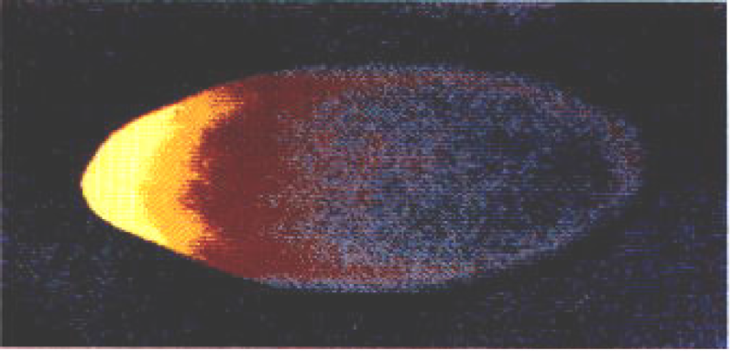
Drosophila zygotic genes
bicoid
Notes:
Bicoid = maternal effect gene - activates
Giant and knirps = gap genes - activate
Even-skipped = pair rule genes - activate
Engrailed = segment polarity gene
Sean B. Carroll, Jennifer K. Grenier, and Scott D. Weatherbee (2001) From DNA to Diversity: Molecular Genetics and the Evolution of Animal Design, Blackwell Publishing:Cambridge, MA, p. 59, fig. 3.5 (http://ncse.com/book/export/html/2188)
http://dev.biologists.org/content/129/19/4399/F5.expansion.html
DevelopmentOctober 1, 2002vol. 129 no. 19 4399-4409

Slide 14
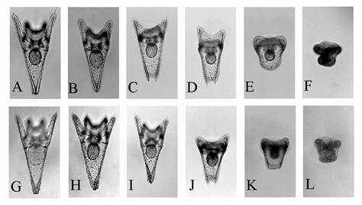
Environmental effects
H. Kurihara & Y. Shirayama (2004) ‘Effects of increased atmospheric CO2 on sea urchin early development.’ Marine Ecology Progress Series, 274: 161-169.
Development can be affected by environmental factors: temperature, pressure, salinity, pH levels etc.
Notes:
“These slides show healthy sea urchin embryos (A, G slides) and others that have become abnormal due to low pH in sea water.”
Increased CO2 = reduced pH
Top row = CO2
Bottom row = HCl
http://www.nbcnews.com/id/4286438/ns/us_news-environment/t/do-global-warming-dangers-lie-under-seas/#.UlzqJtKTzTo

Slide 15
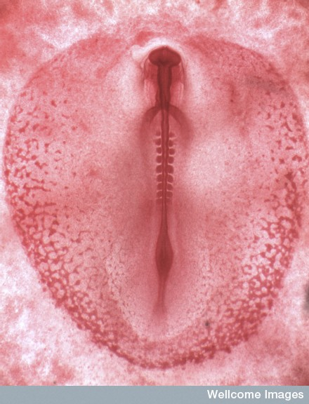
Environmental effects: Neural tube closure
A
B
C
Forebrain
Midbrain
Hindbrain
Spinal
cord
Notes:
B0008179 Credit Kate Storey, Wellcome Images Neurulation : A. Light micrograph of the early chick embryo that has been stained with Sudan red to show the early development of the neural tube and somites. Somites are blocks of tissue formed during early development that will go on to form the skeletal muscle and vertebrae. Incubated for 28 hours or HH9 - as classified by the Hamburger and Hamiliton stage of chick development. At this stage there are 6 somites present and the cranial neural pore and neural tube is still open. Light microscopy Collection: Wellcome Images Copyrighted work available under Creative Commons by-nc-nd 2.0 UK: England & Wales, seehttp://wellcomeimages.org/indexplus/page/Prices.html B. B0008186 Credit Dr David Furness, Wellcome Images Chick embryo : Light micrograph showing chick embryo early in development. At this stage of embryogenesis the body plan is being laid down and the neural tube can be observed as the long structure forming the head to tail axis. The small modular structures running down the neural tube are somites, which are regions of mesodermal tissue that will go on to form skin, skeletal muscle and the vertebrae of the embryo. Light microscopy Collection: Wellcome Images Copyrighted work available under Creative Commons by-nc-nd 2.0 UK: England & Wales, seehttp://wellcomeimages.org/indexplus/page/Prices.html
Image C from Scott Gilbert Developmental Biology, 10th edn.

Slide 16
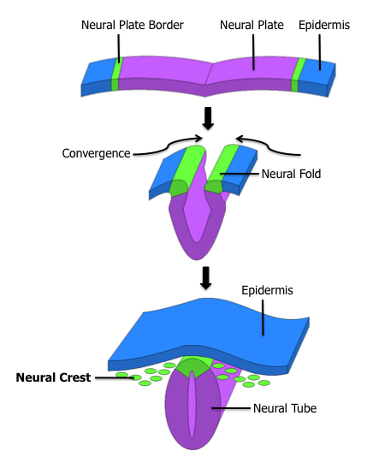
neurulation
Notes:
Let’s just have a quick look at what is happening in the embryo
http://en.wikipedia.org/wiki/File:Neural_Crest.png
This work has been released into the public domain by its author, Abitua at the English Wikipedia project. This applies worldwide. In case this is not legally possible: Abitua grants anyone the right to use this work for any purpose, without any conditions, unless such conditions are required by law.

Slide 17
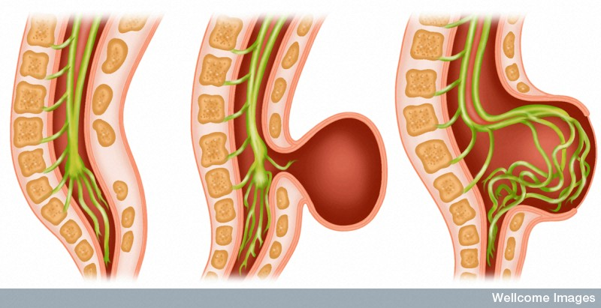
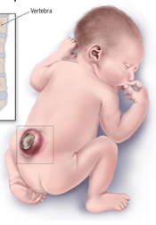
Spina bifida
Notes:
Spina bifida: failure of neural tube to close.
In humans: 1 in 1000 live births
Key time stage around day 27.
Symptoms depend on the degree of failure – Some cases are very mild, with no exposure of spinal nerves and may have no symptoms. Through paralysis, lack of feeling, problems with bladder/bowel function and control, or brain damage due to fluid build up in the brain, to still birth in which the forebrain has not developed,
Very small proportion of cases have a genetic cause
Dietary factors seem most important e.g. Supplementation with folic acid can prevent more than half of all neural tube birth defects
We don’t really understand what folic acid does – may be involved in regulating DNA synthesis during cell division in neural tissues?????
N0026021 Credit Wellcome Images, Wellcome Images. Spina bifida. Colour artwork of spine and spinal cord. Three pictures.. Left - spina bifida of occulta where there is no external protrusion. Centre - spina bifida cystica with a protruding cyst filled with fluid. Right - spina bifida meningomyelocele. Protrusion filled with fluid and spinal cord. Digital artwork/Computer graphic. Collection: Wellcome Images Copyrighted work available under Creative Commons by-nc-nd 2.0 UK: England & Wales, seehttp://wellcomeimages.org/indexplus/page/Prices.html
http://www.cdc.gov/ncbddd/spinabifida/facts.html

Slide 18
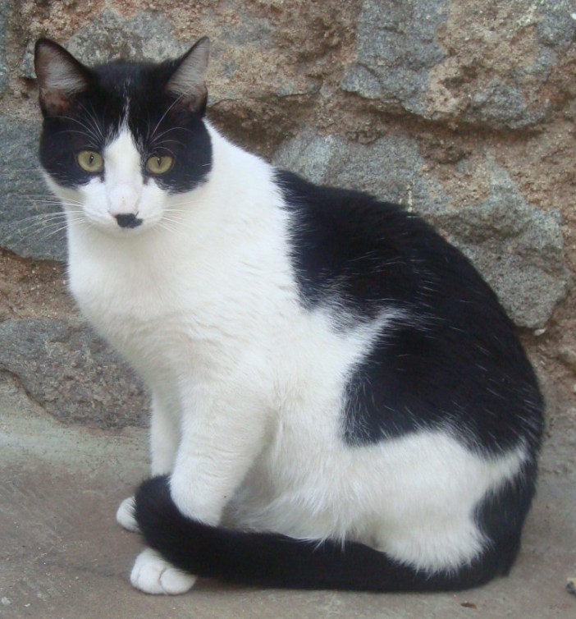
Chance in development
Flikr/ Chodhound
Flikr/ Tambako the Jaguar
Notes:
What do you notice about these cats?
Melanocytes migrate from the neural crest. In cats, the white spotting gene affects this migration.
Recessive homozygotes have no white spotting,
heterozygotes have minor/medium white spotting
dominant homozygotes have extensive white spotting.
The degree of spotting relates to how far the pigment cells migrate before they are interrupted - the reasons for exactly how far the cells get are not completely understood – one element is that there is a time limit and if the cells travel more slowly than normal, they will not reach all the way around the embryo before the “deadline”.
Creative Commons:
You are free:
to Share — to copy, distribute and transmit the work to make commercial use of the work
Under the following conditions:
Attribution — You must attribute the work in the manner specified by the author or licensor (but not in any way that suggests that they endorse you or your use of the work).
No Derivative Works — You may not alter, transform, or build upon this work.
You are free:
to Share — to copy, distribute and transmit the work
to Remix — to adapt the work
to make commercial use of the work
Under the following conditions:
Attribution — You must attribute the work in the manner specified by the author or licensor (but not in any way that suggests that they endorse you or your use of the work).
Share Alike — If you alter, transform, or build upon this work, you may distribute the resulting work only under the same or similar license to this one.

Slide 19
neurulation
Notes:
To come back to this diagram, we’re talking about the neural crest cells we see here
http://en.wikipedia.org/wiki/File:Neural_Crest.png
This work has been released into the public domain by its author, Abitua at the English Wikipedia project. This applies worldwide. In case this is not legally possible: Abitua grants anyone the right to use this work for any purpose, without any conditions, unless such conditions are required by law.

Slide 20
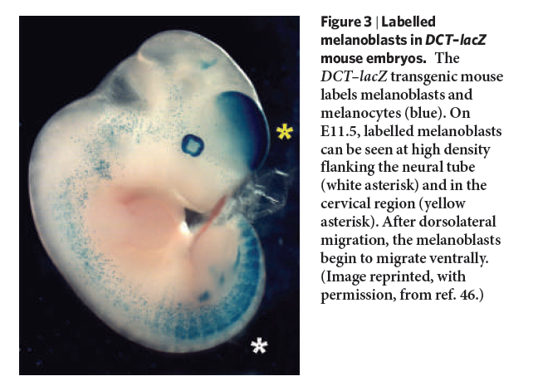
Melanocyte migration
From: Jennifer Y. Lin and David E. Fisher. ‘Melanocyte Biology and Skin Pigmentation’. Nature (Vol 445) 22 February 2007. Doi: 10.1038/nature05660
Notes:
And here we can see the migrating melanocytes in a mouse embryo
Jennifer Y. Lin and David E. Fisher. ‘Melanocyte Biology and Skin Pigmentation’. Nature (Vol 445) 22 February 2007. Doi: 10.1038/nature05660

Slide 21
Chance in development
Flikr/ Chodhound
Flikr/ Tambako the Jaguar
Notes:
Creative Commons:
You are free:
to Share — to copy, distribute and transmit the work to make commercial use of the work
Under the following conditions:
Attribution — You must attribute the work in the manner specified by the author or licensor (but not in any way that suggests that they endorse you or your use of the work).
No Derivative Works — You may not alter, transform, or build upon this work.
You are free:
to Share — to copy, distribute and transmit the work
to Remix — to adapt the work
to make commercial use of the work
Under the following conditions:
Attribution — You must attribute the work in the manner specified by the author or licensor (but not in any way that suggests that they endorse you or your use of the work).
Share Alike — If you alter, transform, or build upon this work, you may distribute the resulting work only under the same or similar license to this one.

Slide 22
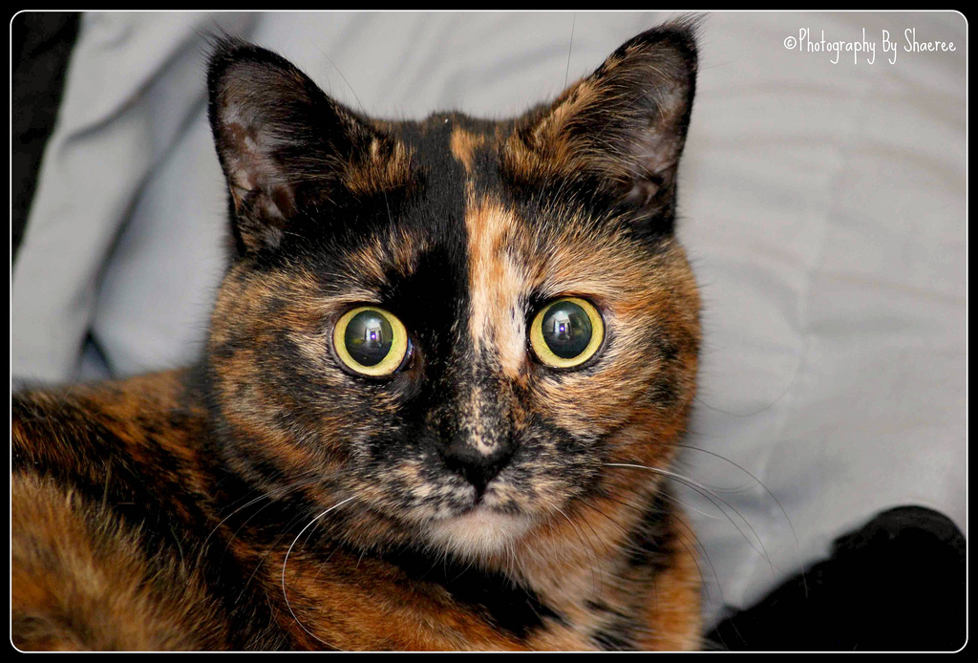
Chance in development: X-inactivation
Source: Shaeree/ Flikr

Slide 23
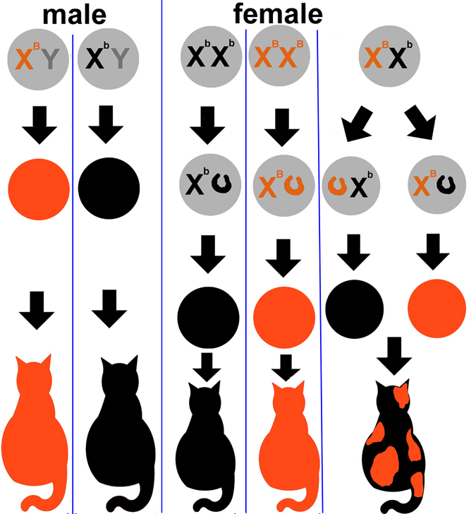
X inactivation (lyonization)
Notes:
http://www.bio.miami.edu/dana/dox/calico.html
Lyonization after Mary Lyon who theorised this process in the early 1960s.
Female cats (and all other mammals, and Drosophila) have two X-chromosomes, while males have only one.
However, males and females still have the same amount of protein products of the genes on the X chromosome – this phenomenon is called dosage compensation. In mammals, this is achieved by turning off, or inactivating one of each pair of X chromosomes in the cells of the female.
Whether this is the paternal or maternal chromosome is random.
The inactivation of the chromosome is irreversible and happens quite early in development (about day 6 in mice). Once an X is inactivated, all the subsequent products of cell division will have the same one inactivated too.
This means that females are a mosaic of two kinds of cells – one kind has the maternal X and the other the paternal X.
Tortoiseshell cats give us an excellent demonstration of this because the locus involved in red/black coat colour is carried on the X. One allele is red (ginger) the other is black
Talk through instances on this diagram

Slide 24
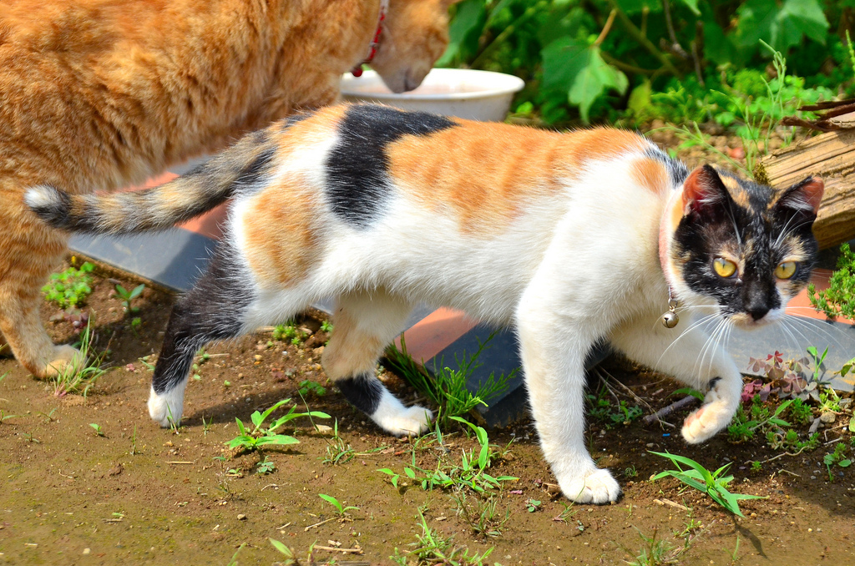
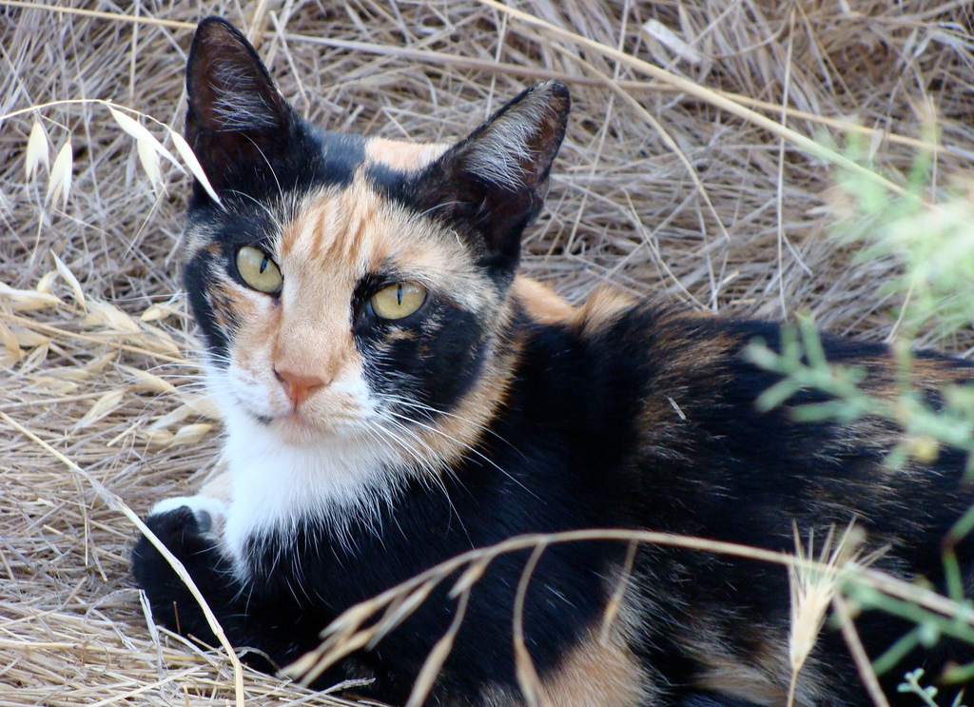
Source: Shaeree/ Flikr
Source: Dakiny/ Flikr
Source: Julia Manzerova/ Flickr
Notes:
The result is random distribution of the two colours

Slide 25
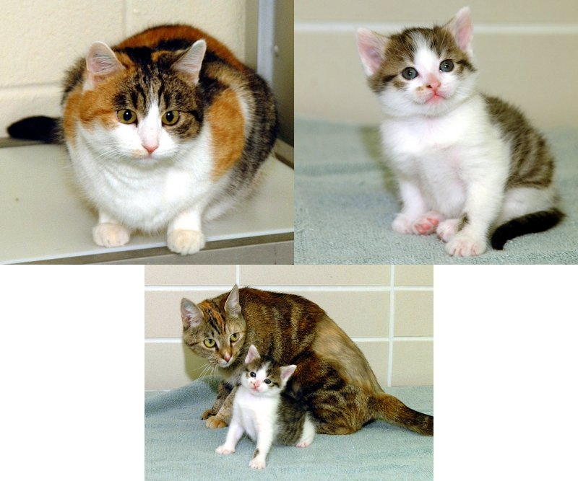
Rainbow and Copycat the cloned kitten
Notes:
And if we take both of these sources of chance variation into account, we can explain why CC the cloned kitten is physically quite dissimilar to the cat from which she was cloned
http://www.mun.ca/biology/scarr/Cloned_Cat.html COPYRIGHT ISSUES
Cell biology: A cat cloned by nuclear transplantation: Taeyoung Shin, Duane Kraemer, Jane Pryor, Ling Liu, James Rugila, Lisa Howe, Sandra Buck, Keith Murphy, Leslie Lyons and Mark Westhusin Nature 415, 859(21 February 2002) doi:10.1038/nature723

Slide 26
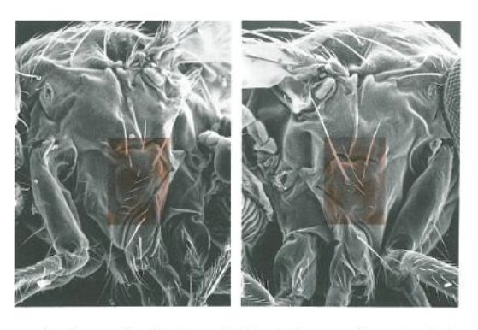
Developmental noise
Richard Lewontin, “Genes, Environment, and Organism”, in Human Diversity, New York: Scientific American Library, 1982, pp.14-28
Notes:
Cell specification, developmental signalling and cell migration can al be affected by chance fluctuation in levels of signalling chemicals, by a minor environmental change that affects the chemical properties of a signalling molecule etc.

