Slide 1
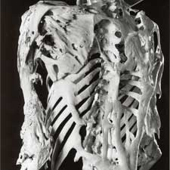
Lecture 4: How does it all work 2
Genetics Pedagogies Project
Annie Jamieson (A.K.Jamieson@leeds.ac.uk)
Notes:
Last week, we saw how DNA is replicated and processed – how the continuity we observe in inheritance is achieved. This week we have a review of how changes in any of the processes covered in lecture 3 can affect the ways in which a gene is expressed – this can be both via changes in the DNA sequence itself, or by processes that regulate expression of genes.
(fibrodysplasia ossificans progressiva (FOP) shows the extensive bone growth that happens when soft tissue cells get the wrong message. Due to a mutation in a gene involved in the differentiation of cartilage and bone cells – so cartilage turns inappropriately to bone)
http://www.scientificamerican.com/article.cfm?id=genetic-mutation-muscle-bone – COPYRIGHT ISSUES

Slide 2
Mutations (changes in the DNA sequence)
Spontaneous mutations
Replication errors
Chemical changes in bases
Minor chemical changes in bases can lead to e.g C changing to U or T, or loss of bases leaving a gap in the DNA sequence, which is then filled randomly by any of the 4 bases
Notes:
Estimates of the mutation rate in humans vary – around 50-150 per generation
Many mutations are never revealed to us – if they cause significant effects, the zygote may not develop beyond a few cell divisions, and the woman would not even known she had conceived.

Slide 3
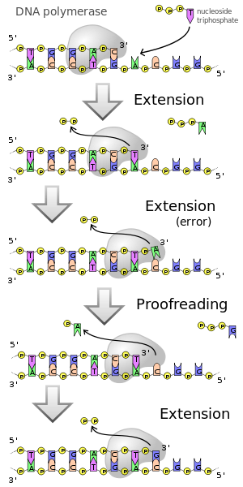
Replication errors
Replication is balanced between speed and accuracy
DNA polymerase can accidentally insert the wrong base
Proof reading mechanisms normally correct the errors, but not always
Wikimedia Commons/ Madeleine Price Ball
Notes:
“Replication fork speed of ~ 2000 base pairs/min=2000/60 base pairs/sec = 33 base pairs/sec” (http://www.bionumbers.hms.harvard.edu/bionumber.aspx?id=104136&ver=9)
Human genome = c. 3 billion base pairs
The total genome is replicated in around 8 hours (replication takes place at many replication forks at once)
In fast-dividing cells, like the intestinal epithelium, mutations occur in approx 1 in 4 cell divisions
The rate of cell division is highly variable – some embryonic cells can divide in 30m or less, and typical In e.g. liver cells, the cell cycle can last for a year, while cells in the intestinal epithelium divide every two days, and neurons (to all intents and purposes) never divide again once they have differentiated
I, Madprime, the copyright holder of this work, hereby publishes it under the following licenses: This file is made available under the Creative Commons CC0 1.0 Universal Public Domain Dedication.The person who associated a work with this deed has dedicated the work to the public domain by waiving all of his or her rights to the work worldwide under copyright law, including all related and neighboring rights, to the extent allowed by law. You can copy, modify, distribute and perform the work, even for commercial purposes, all without asking permission.
Permission is granted to copy, distribute and/or modify this document under the terms of the GNU Free Documentation License, Version 1.2 or any later version published by the Free Software Foundation; with no Invariant Sections, no Front-Cover Texts, and no Back-Cover Texts. A copy of the license is included in the section entitled GNU Free Documentation License.
This file is licensed under the Creative Commons Attribution-Share Alike 3.0 Unported license.Attribution: I, MadprimeYou are free:to share – to copy, distribute and transmit the work
to remix – to adapt the work
Under the following conditions:attribution – You must attribute the work in the manner specified by the author or licensor (but not in any way that suggests that they endorse you or your use of the work).
share alike – If you alter, transform, or build upon this work, you may distribute the resulting work only under the same or similar license to this one.
This licensing tag was added to this file as part of the GFDL licensing update.

Slide 4
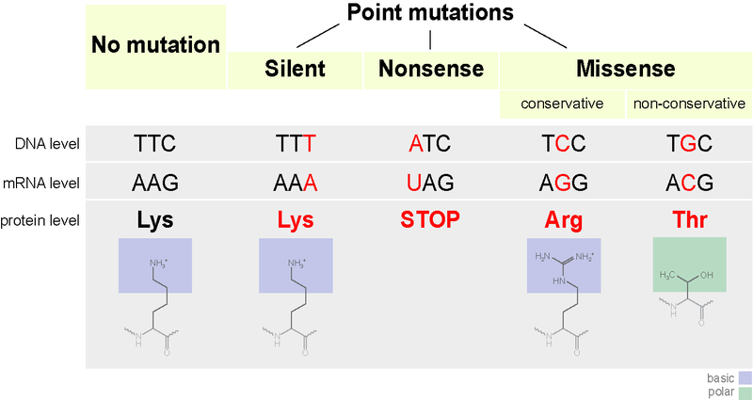
Point mutations: mis-sense and nonsense
Wikimedia Commons
Notes:
The result of replication errors (or chemical changes in bases) is a point mutation – these affect a single codon but can still have significant effects on the protein product, depending on the exact change and where in the sequence it occurs
Silent point mutation: a base is replaced such that the resulting new codon encodes the same amino acid as the original i.e. Lysine is encoded by either AAG or AAA
Nonsense point mutation: the point mutation leads to a STOP codon so that the protein is truncated prematurely. The resulting protein will have limited or no function depending on where the STOP occurs
Mis-sense mutation:
conservative: the new codon gives an amino acid that has similar properties to the original;
non-conservative: the new amino acid has very different properties to the original – this could result in a non-functional protein, or in one that does something quite different to the original = a new phenotype
I, the copyright holder of this work, hereby publish it under the following licenses:Permission is granted to copy, distribute and/or modify this document under the terms of the GNU Free Documentation License, Version 1.2 or any later version published by the Free Software Foundation; with no Invariant Sections, no Front-Cover Texts, and no Back-Cover Texts. A copy of the license is included in the section entitled GNU Free Documentation License.
This file is licensed under the Creative Commons Attribution-Share Alike 3.0 Unported, 2.5 Generic, 2.0 Generic and 1.0 Generic license.You are free:to share – to copy, distribute and transmit the work to remix – to adapt the work. Under the following conditions:
attribution – You must attribute the work in the manner specified by the author or licensor (but not in any way that suggests that they endorse you or your use of the work).
share alike – If you alter, transform, or build upon this work, you may distribute the resulting work only under the same or similar license to this one.

Slide 5
Normal sequence
Gene product
Base DELETION
Gene product
Base INSERTION
Gene product
THEFATCATANDTHEBIGRATANDONEREDANTATETHEPIEANDLAYLOWALLDAY
THE FAT CAT AND THE BIG RAT AND ONE RED ANT ATE THE
PIE AND LAY LOW ALL DAY
THEFATCATANDTHEBIGRATANDONEREDANTATETHEPIEANDLAYLOWALLDAY
THE FAT CAT ANT HEB IGR ATA NDO NER EDA NTA TET HEP IEA NDL AYL OWA LLD AY
THEFATCATANDTHHEBIGRATANDONEREDANTATETHEPIEANDLAYLOWALLDAY
THE FAT CAT AND THH EBI GRA TAN DON ERE DAN TAT ETH EPI EAN DLA YLO WAL LDA Y
Notes:
In addition to point mutations, we also see spontaneous deletions and insertions = frameshifts

Slide 6
frameshifts
G
A
U
G
A
U
U
C
A
U
U
G
G
C
C
C
U
A
G
Start
Ile
His
Trp
Pro
Stop
A
U
G
A
G
U
U
C
A
U
U
G
G
C
C
C
U
A
G
Start
Ser
Ser
Leu
Ala
Leu
Notes:
Frameshifts always affect every codon after the mutation

Slide 7
Mutations (changes in the DNA sequence)
Mutations induced by environmental factors
Changes caused by chemical mutagens
Changes caused by radiation (X-ray, gamma or ultra-violet)

Slide 8
Chemical mutagens: base-modifying agents
Nitrous acid
A
T
G
A
C
T
C
A
T
T
G
C
A
T
U
G
C
T
A
G
Replication
T
A
C
T
G
A
T
G
T
A
A
C
A
G
A
C
G
A
T
C
Replication
A
T
G
A
C
T
C
A
T
T
G
C
A
T
T
G
C
T
A
G
Notes:
Base-modifying agents
Make chemical changes to a single base
e.g. nitrous acid changes cytosine to uracil – leading to a change from CG-TA pair
ENU is known as a supermutagen – used in the 1993-5 zebrafish screen. Induces point mutations at a rate of 1 in 700 loci
In this screen 49 mutagenized males (because sperm cells are continuously produced and susceptible to DNA damage) produced over 1000 mutant strains

Slide 9
Chemical mutagens: base analogs
A
T
G
A
C
T
A
C
A
T
T
G
T
C
G
C
T
A
G
T
A
C
T
5BU
G
A
T
G
T
A
A
C
A
G
C
G
A
T
C
Replication
A
T
G
A
C
T
A
C
A
T
T
G
T
C
G
C
T
A
G
5BU changes state
T
A
C
5BU
G
A
T
G
T
A
A
C
A
G
C
G
A
T
C
A
T
G
G
C
T
A
C
A
T
T
G
T
C
G
C
T
A
G
Replication
T
A
C
5BU
C
G
A
T
G
T
A
A
C
A
G
C
G
A
T
C
Notes:
Base analogs replace normal bases during replication
chemically similar to normal bases but can spontaneously change state
e.g. 5-bromouracil
In one state, pairs with A in place of T
When it changes state it pairs with G
Result is that an A-T pair is replaced with a C-G pair
And the reverse can happen if the 5BU is in its G binding state when it is incorporated

Slide 10
Chemical mutagens: intercalating agents
A
T
G
A
C
T
A
C
A
T
T
G
T
C
G
C
T
A
G
Acridine inserts into the DNA template strand
Acridine
A
T
G
A
C
T
A
C
A
T
T
G
T
C
G
C
T
A
G
At replication, resulting gap in new strand is filled at random by any one of the 4 bases
T
A
C
T
G
A
T
G
T
A
A
C
A
T
G
C
G
A
T
C
Resulting in a frameshift
A
T
G
A
C
T
A
C
A
T
T
G
T
A
C
G
C
T
A
G
Notes:
Intercalating agents e.g. acridine
insert themselves between bases in the strand, creating a gap that is complemented at random during DNA replication

Slide 11
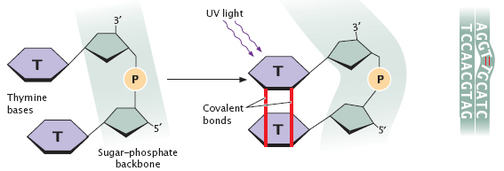
EFFECTS OF uv LIGHT ON DNA
Thymine dimers can form 50+ times/s in a cell
Generally fixed by repair mechanisms
Over-exposure to UV overwhelms the repair mechanisms → cell damage and cell death (sunburn symptoms)
Unrepaired dimers in certain genes (e.g. p53 tumour suppressor) can lead to skin cancer
Notes:
High energy radiation causes breaks in the DNA strand
UV exposure causes formation of thymine dimers
This can happen up to 50-100 times per second in a cell exposed to UV
Normally the cell’s repair mechanisms can deal with these
However, if you are over exposed the number of dimers that form is too much for the repair processes to deal with and the cell is damaged and will die – this leads to the effects we see with sunburn
The thymine dimers can form in genes involved in cell division etc (e.g. p53 tumour suppressor), preventing expression and this can lead to uncontrolled cell division i.e. cancer
Note that this is a statistical phenomenon – exposure doesn’t entail the development of cancer, but, the more exposure, the more thymine dimers, the less change they will be repaired, and the greater chance they will occur in a crucial gene
http://www.nature.com/scitable/topicpage/dna-damage-repair-mechanisms-for-maintaining-dna-344

Slide 12
Consequences of mutations
stable mutation  a variant allele
Haplophenotype = phenotype associated with a single allele
Silent or conservative mutations  no phenotypic effect
Mis-sense, non-conservative or frameshifts  non-functioning, malfunctioning or differently functioning protein
individual heterozygous for the mutant allele could have a number of phenotypes
If the product of a single copy of the ‘normal’ allele is sufficient for normal function (i.e. haplosufficient) the mutation will have no effect on the individual
If the normal allele is not haplosufficient, the individual may suffer a disorder
Severity depends on how much the function of the mutant is affected
An individual homozygous for the mutant allele will suffer more severe symptoms than a heterozygote
Notes:
Haplophenotypes – the phenotype influenced by one allele
Where the product of a single gene is sufficient for normal function - haplosufficiency

Slide 13
Heterozygote where normal allele is haplosufficient
Phenotype = normal
M
M
Heterozygote where normal allele is not haplosufficient
Phenotype = mutant
M
M
Homozygous for mutant allele
Phenotype = mutant

Slide 14
Epigenetics
Molecular mechanisms that alter the way genes are expressed, therefore alter the phenotype (without changing the DNA sequence)
Can be mediated by environmental factors e.g. honey bees (but not always)
Can be passed on to offspring (but not always)
DNA methylation
Histone acetylation/methylation
Notes:
So – all the above change the DNA sequence
The changes that dictate that a bee should become a worker or a queen are epigenetic changes that appear to be in response to feeding (or not) royal jelly (not yet fully understood)

Slide 15
RNA-coding sequence
Promoter
Terminator
DNA
INTRON
EXON
DNA
A
T
C
G
A
T
C
G
C
G
C
G
C
G
T
A
A
T
M
M
M
M
M
MeCP2
MeCP2
MeCP2
MeCP2
MeCP2
METHYLATION = addition of a methyl group to C at CpG motif
CpGs cluster in promoter regions
MeCP2 binds to methylated C
Promoter region becomes blocked so that RNA polymerase cannot bind to initiate transcription
Gene is “shut down”
Notes:
Methylation: the addition of a methyl group (1 carbon and 3 hydrogen atoms) to a C base at a CpG motif (C followed by G)
CpGs cluster at promoter regions
Methylated cpG binds MeCP2 which in turn binds other proteins that shut down transcription, preventing RNA polymerase from binding
This process is more or less permanent
E.g.In neurons, which cease division after differentiation
In skin cells, which pass on the methylation to their daughter cells so that skin cells only ever produce more skin cells

Slide 16
Dna Methylation: Rett syndrome
Affects 1 in 10,000 females
Develop normally for up to 18m
Intellectual impairments
Slow growth
Small head
Seizures
Most cases due to a mutation in MECP2
Most cases are de novo (new ) mutations
Notes:
http://ghr.nlm.nih.gov/condition/rett-syndrome
Affects 1 in 10000 females
In Rett Syndrome, a mutation on the MeCP2 gene means that cells can’t read the methylation, so can’t shut down transcription appropriately, resulting in over-expression of certain other genes (over 300 different mutations have been noted)
Why females? – MECP2 is on the X chromosome – so females, having 2 X-chomosomes, one randomly inactivated in each cell, might have up to 50% of cells with a working copy of the gene, whereas males have only 1 X, so no functioning protein, therefore die during development or in very early infancy

Slide 17
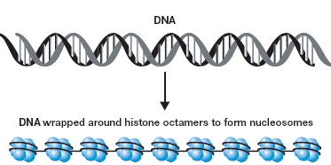
Histone proteins
~2m DNA in every cell
Packaged around histone proteins
Notes:
Histones
DNA is packaged around groups of histone molecules (each cell has around 2m of DNA)
We’ll look at this packaging in more detail next week when we look at chromosome structure
15 years ago, the story about histones would have ended here but it brings us to the cutting edge of genetics today (see Nessa Carey’s book if you want to know more)
http://www.abcam.com/index.html?pageconfig=resource&rid=9 COPYRIGHT ISSUES

Slide 18
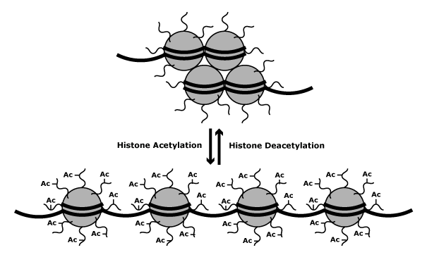
HISTONE ACETYLATION (or methylation)
Amino acid tails
Notes:
The histones have amino acid tails, acetylation of these tails increases gene expression
Acetyl group = COCH3
Acetylation of the amino acid tail of the histones reduces the affinity of the histones for DNA – “weakens the bond”, loosening the structure and making the DNA more accessible for transcription.
This process is generally reversible – allows fine-tuning of gene expression
http://missinglink.ucsf.edu/lm/genes_and_genomes/acetylation.html COPYRIGHT ISSUES

Slide 19
Histone methylation: Kabuki syndrome
Affects 1 in 32,000 live births
Developmental delay
Intellectual impairments
Small stature
Seizures
Characteristic facial features
50-75% cases due to mutations in MLL2 gene
Mainly de novo mutations
Non-functioning MLL2 → failure to activate certain genes
Notes:
1 in 32,000 births (2/3 cases have an epigenetic factor)
50-75% MLL2 (aka KMT2D) on chromosome 12
Range of other symptoms
http://ghr.nlm.nih.gov/condition/kabuki-syndrome

Slide 20
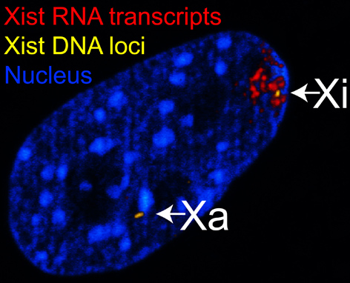
X-inactivation is an epigenetic process
Source: Julia Manzerova/ Flickr
Notes:
Remember our tortoiseshell cats from lecture 2 – due to X-inactivation
X chromosome has about 1300 genes
X inactivation is an epigenetic process
Xist gene is only expressed in the inactive X (a non-coding RNA)
English: The figure shows confocal images from a combined RNA-DNA FISH experiment for Xist in female mouse fibroblast cells (Female-biased expression of long non-coding RNAs in domains that escape X-inactivation in mouse, B Reinius et al 2010, BMC Genomics (6), http://www.biomedcentral.com/1471-2164/11/614/abstract). The figure was adapted from Figure 5 in the original publication and contrast was adjusted to make the figure clear in thumbnail format. Open access: Unrestricted use, distribution and reproduction in any medium is permitted, provided the original article is properly cited.
Date1 April 2010SourceFemale-biased expression of long non-coding RNAs in domains that escape X-inactivation in mouse, B Reinius et al 2010, BMC Genomics (6), http://www.biomedcentral.com/1471-2164/11/614/abstractAuthorB Reinius & C Shi
The permission to use this work has been archived in the Wikimedia OTRS system. It is available as ticket #2010110410013359 for users with an OTRS account. If you wish to reuse this work elsewhere, please read the instructions at COM:REUSE. If you are a Commons user and wish to confirm the permission, please leave a note at the OTRS noticeboard.Ticket link: https://ticket.wikimedia.org/otrs/index.pl?Action=AgentTicketZoom&TicketNumber=2010110410013359

Slide 21
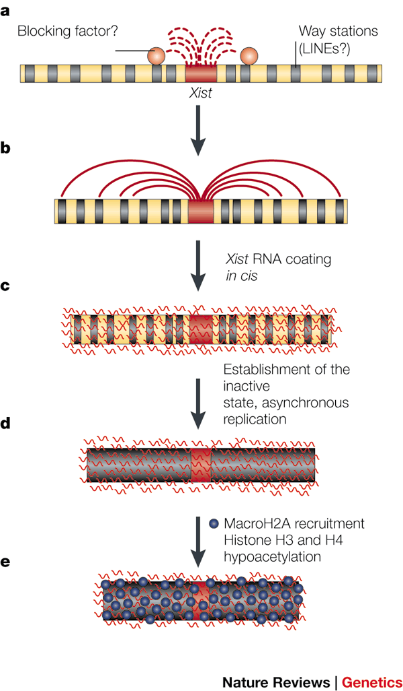
The inactive X chromosome (Xi) produces Xist non-coding RNA
ncRNA binds to Xi
histone changes and repressor recruitment
Xi becomes tightly “wound up” so that no transcription (other than Xist) can take place
These modifications are passed on to daughter cells at cell division
Notes:
Binds to the inactive X
More histone changes take place and more repressors accumulate
X becomes very tightly “wound up” so that no transcription (other than Xist) can take place
This process is triggered by a “kiss” between the two X chromosomes
These modifications are passed from mother to daughter cells
FROM THE FOLLOWING ARTICLE: COPYRIGHT ISSUES
X-chromosome inactivation: counting, choice and initiation
Philip Avner & Edith Heard
Nature Reviews Genetics 2, 59-67 (January 2001)
doi:10.1038/35047580
http://www.nature.com/nrg/journal/v2/n1/fig_tab/nrg0101_059a_F5.html#figure-title

Slide 22
Inherited Epigenetic effects
From Nessa Carey (2012) The Epigenetics Revolution, London: Icon Books, Fig. 6.1, p. 102.
Notes:
In the Dutch Hunger Winter (Nov 1944 - May 1945), due to combination of blockades preventing food supplies getting through and very severe weather conditions, reducing local supplies, widespread malnutrition in Netherlands. 20K people died of starvation
Good medical record keeping means that we can study the effects.
If we look at pregnant women at the time:
If they were malnourished in the 1st trimester, and then ate normally for the rest of the pregnancy, their babies were normal weight at birth If they ate normally in the first stages of the pregnancy, but were malnourished in the last trimester, their babies were born small (this is to be expected because most growth takes place in the last trimester).
But when we look at the next generation, we see something really interesting – the children of the normal babies (whose mothers had been malnourished in the 1st trimester) were likely to be heavier than average.
Related effects have been observed in male lineages:
In an isolated region of northern Sweden in the late 19th and early 20th centuries, there were periodic food shortages, interspersed with periods of plentiful food supply – so you would eat a lot when you got the chance!
Men who went through a period of food shortage in their slow growth period (years before puberty, around 9-12) had sons with a decreased risk of CVD (and grandsons with reduced risk of diabetic disease)
Men who had plentiful food during SGP had grandsons with an increased risk of diabetic diseases

Slide 23
Evidence for inherited epigenetic effects
In mice
♂ on low protein, high sugar diet x ♀ on normal diet  offspring with abnormal patterns of expression of metabolic genes and changes in epigenetic modifications in the liver
In rats
Exposure of pregnant ♀ to vinclozolin  ♂ pups with defective testicles and reduced fertility
Effect appears in 90% of ♂ pups in the next 3 generations
Notes:
Now, we don’t know the mechanisms of these phenomena (yet, at least) but there is some evidence from studies of animal models
For example, (in a particular inbred strain of mice)
When males are fed a low protein, high sugar diet, and females are fed normally, the offspring show abnormal patterns of expression in genes involved in metabolism, and changes in epigenetic modifications in the liver
When pregnant female rats are exposed to high doses of a fungicide called vinclozolin (used in wine making) at a certain point in pregnancy, their male offspring are born with defects in development of the testicles and reduced fertility AND 90% of males are affected for the next 3 generations
A later study showed that exposure to vinclozolin leads to unusual patterns of DNA methylation (suggesting it’s an epigenetic effect)

